Slide 1

JavaScript – language VAVJS 2019
Because JavaScript can be used without understanding, the understanding of the language is often never attained (@getify)

Slide 2
JavaScript Language
JavaScript® (often shortened to JS) is
a lightweight,
interpreted, (??? or compiled)
object-oriented language
with first-class functions,
and is best known
as the scripting language for Web pages,
but it's used in many non-browser environments as well
It is a prototype-based,
multi-paradigm scripting language
that is dynamic,
and supports
object-oriented,
imperative,
and functional programming styles
… (and more built upon these basics)
https://developer.mozilla.org/en-US/docs/Web/JavaScript/About_JavaScript

Slide 3
JavaScript, ECMAScript
MDN: ECMA-262 standard in June 1997
JavaScript is one of implementations
others are ActionScript, JScript
JavaScript is standardized by ECMA-262 standard
ECMA:
This Ecma Standard defines the ECMAScript 2017 Language
ECMAScript is based on several originating technologies, the most well‑known being JavaScript (Netscape) and JScript (Microsoft)
TC39:
Ecma International's TC39 is a group of JavaScript developers, implementers, academics, and more, collaborating with the community to maintain and evolve the definition of JavaScript. https://tc39.es
JavaScript trademark (Oracle) https://news.ycombinator.com/item?id=8344049

Slide 4
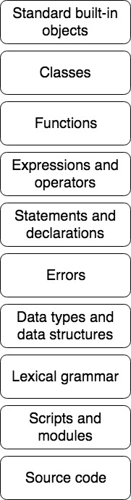


ES – Building Blocks
ECMA 262 Standard and JavaScript Reference
http://www.ecma-international.org/ecma-262/10.0/index.html
https://developer.mozilla.org/en-US/docs/Web/JavaScript/Reference
Notes:
iamge destiled from MDN and https://tc39.github.io/ecma262

Slide 5
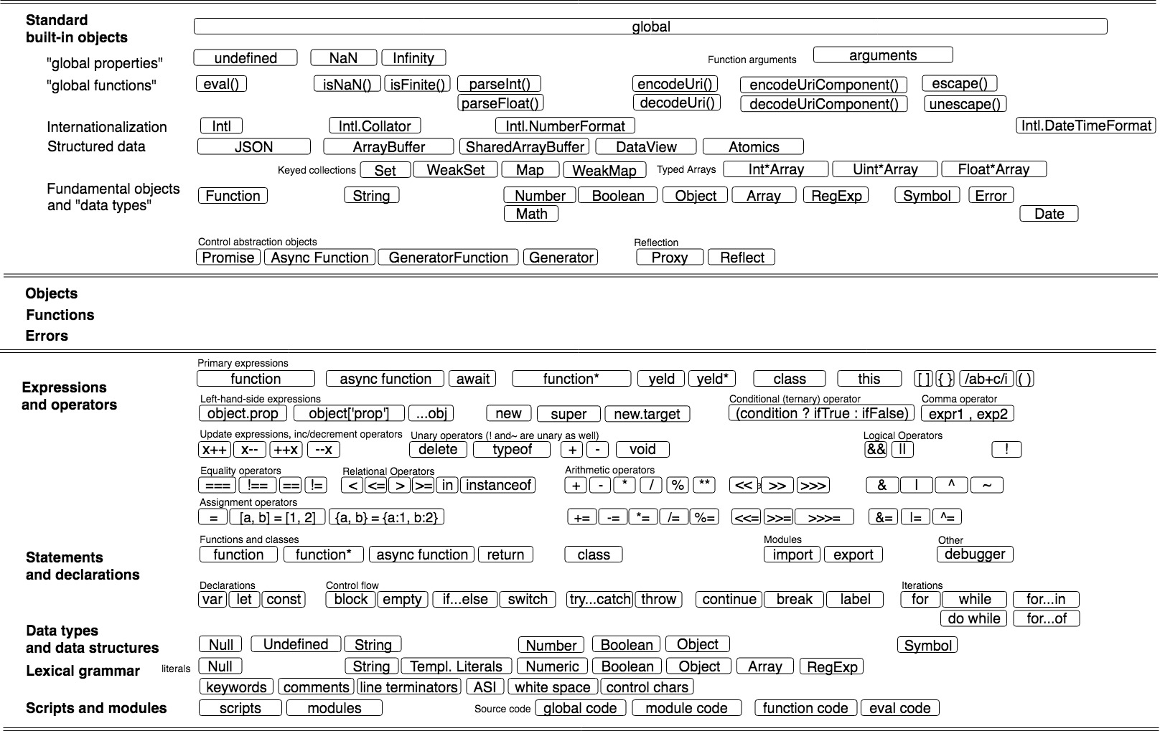
ES – Building Blocks
Notes:
Z čoho pozostáva jazyk ?
Prečo je/nie je terminológia dôležitá ?
Špecifikácia vs Reference Guide.

Slide 6
Source Code, Scripts (and Modules)
http://www.ecma-international.org/ecma-262/10.0/index.html#sec-ecmascript-language-source-code
ECMAScript code is expressed using Unicode. ECMAScript source text is a sequence of code points.
....
The actual encodings used to store and interchange ECMAScript source text is not relevant to this specification.
....
JS zdroják je spravidla texový súbor (alebo serverom generovaný stream)
Zdroják by mal byť enkódnutý v UTF-8 (node.js to vyžaduje pre browsre je to common practice), žiadne windows-1250 please.
Browser:
Html stránka z <script=test.js>
Content Encoding header
Node:
node tests.js

Slide 7
sample
open ./02-prednasky/samples/01-source-code/app.html
loads html page
loads js source codes
executes JS
node ./02-prednasky/samples/01-source-code/app.js
loads js source codes
executes JS
Môžeme mať kód, ktorý beží aj v browsri aj na servri (node.js)
Tie kódy, ktoré nerobia interakciu a IO, interakcia a IO budú v oboch prípadoch iné

Slide 8
ES – “Variable” Declarations
let, const and var
Scope
Hoisting
Mutability
let, var
const
Scope (Lexical Environment)
let, const – block or global
var - function or global

Slide 9
ES – Data Types
Ref Guide (7 ES Types)
Prax (čo sa musíme naučiť)
JavaScript is a loosely typed or a dynamic language. Variables in JavaScript are not directly associated with any particular value type, and any variable can be assigned (and re-assigned) values of all types
ECMAScript standard defines seven data types
Six data types that are primitives: Boolean, Null, Undefined, Number, String, Symbol and Object
primitive types are immutable
Ako zapisujeme jednotlive datove typy (number literals, string literals, …)
Ako sa pracuje z jednotlivými typmi a čo s nimi môžeme robiť (API)
Ako zisťujeme akého typu je daná premenná, parameter
Konverzie, coercion
Equality
...
…
https://developer.mozilla.org/en-US/docs/Web/JavaScript/Data_structures

Slide 10
ES – Data Types
ES Data Type
ES Build In
(any)
(primitive)
object
undefined
null
Object
Function
symbol
Symbol
1. define methods
of primitives
2. perform explicit
conversion
string
String
number
Number
boolean
Boolean
Date
build in
„data structures“
RegExp
Array
Set
Map
...
...

Slide 11
Primitives
Normal primitives
Special primitives
string
number
boolean
Primitives have methods ;-) JS is strongly OO oriented, for each primitive there is wrapper object defining it‘s API
Primitives are immutable i.e., they cannot be altered, the existing value can not be changed in the ways that objects, arrays, and functions can be altered
undefined - A variable or object property that has not been assigned (yet)
null - represents the intentional absence of any object value
symbol – object keys were strings, name clash. Symbols can be viewed as mechanism for unique naming and sort of private propereties as well

Slide 12
samples
Ako zapisujeme premenné jednotlivých typov:
$ subl ./02-prednasky/samples/02-data-types/data-types.js
String, Number and Boolean have methods (thanx to build in wrappers)
$ subl ./02-prednasky/samples/02-data-types/primitives-have-methods.js

Slide 13
typeof operator
Keďže sme v netypovom jazyku, potrebujeme sa niekedy spýtať či je daná hodnota String alebo Number alebo Dátum a podľa toho pokračovať.....
Niekoľko strategií:
typeof – staci len na primitivne typy
*.is* funkcie – Array.isArray(), Number.isFinite()
Object.prototype.toString
instanceof
constructor
knižnice – navznikali kadejake
TypeScript - ?????
Duck Typing ? (ozaj potrebujeme vediet typ, alebo ci podporuje moju metodu ?)
Security attacks.... Based on bad checks
Použitie silne záleží na tom čo a kde kódujeme

Slide 14
Samples
$ subl ./02-prednasky/samples/03-checking-type/01-typeof.js
$ subl ./02-prednasky/samples/03-checking-type/02-other-checks.js
Kniznice:
https://www.npmjs.com/package/is
https://bit.dev/lodash/lodash/lang/~code
https://github.com/nodejs/node/blob/master/lib/util.js

Slide 15
strings
literals - double or single quotes
template literals (backtick)
escape notation for special characters \n,\t, ...
unicode and hex escape sequences (\u,\u{},\x)
unicode
bytes, chars, codePoints, encoding
operators - applicable on strings
String – API of Strings defined by build in wrapper
immutable, char vs. codePoints APIs, local sensitive insensitive
Conversions and coercion
i18n – sorting and Collation
typeof - and checking if string
https://developer.mozilla.org/en-US/docs/Web/JavaScript/Reference/Global_Objects/String
https://developer.mozilla.org/en-US/docs/Web/JavaScript/Guide/Text_formatting#String_literals

Slide 16
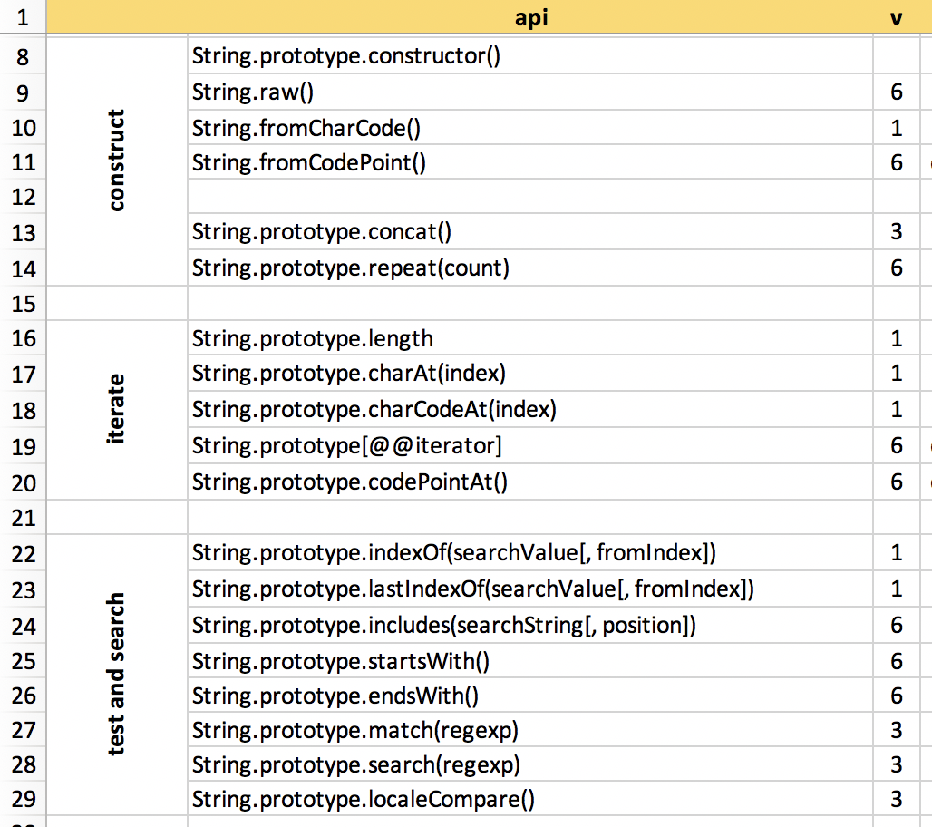
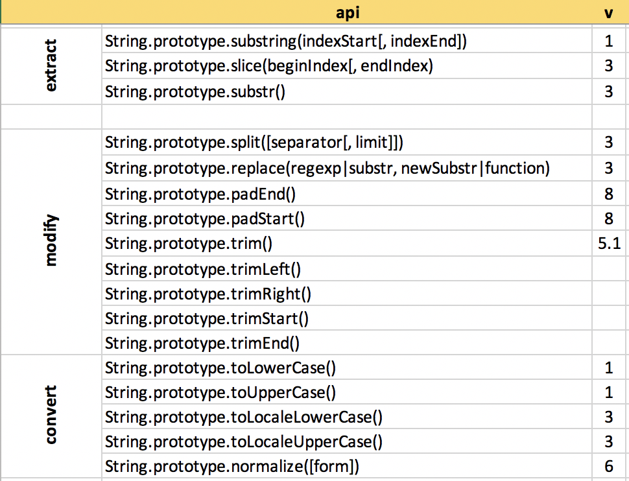
String API
https://developer.mozilla.org/en-US/docs/Web/JavaScript/Reference/Global_Objects/String
Notes:
TODO: change to include codepoints flags

Slide 17
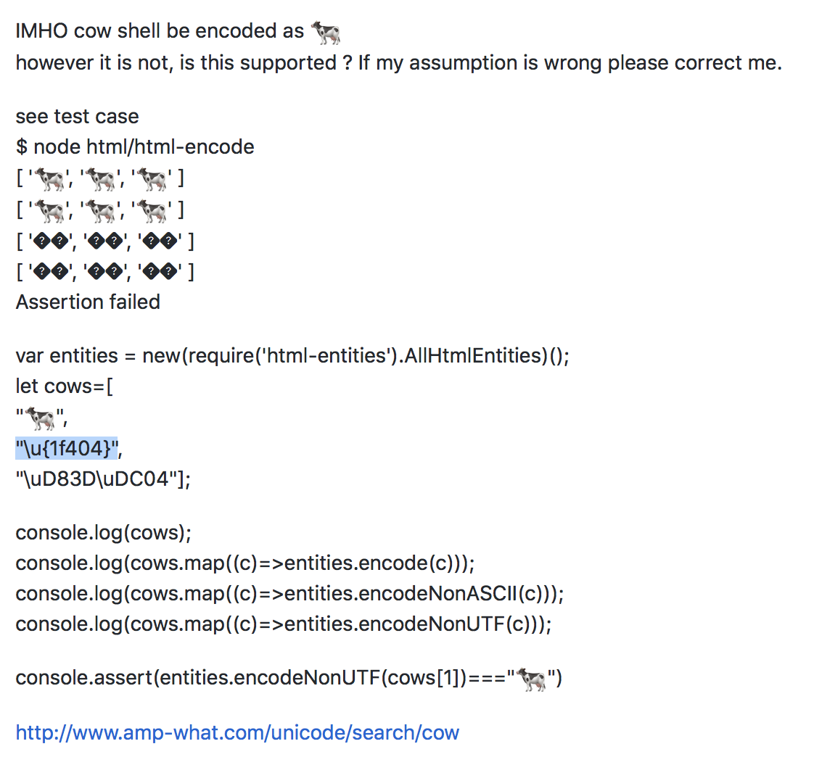
String API – codepoints vs. chars
Array.from("\u{1f404}")
TODO: other examples
lack of basic knowledge may lead to incorrect libraries
"\u{1f404}".split("")

Slide 18
Conversions
string -> array
useful when you want to use array API on strings (map, filter, reduce) or reverse(), sort() etc…
cps=Array.from(s)
cps=[…s]
chs=s.split("")

Slide 19
number
literals - four types of number literals: decimal, binary, octal, and hexadecimal
double-precision 64-bit binary format IEEE 754 (i.e. a number between -(2⁵³ -1) and 2⁵³ -1)
no integer specific type
three symbolic values: +Infinity, -Infinity, and NaN
Two zeros 0 and -0
operators - applicable on numbers
Number - API of number is defined by build in wrapper Number object
immutable, rounding and modes, coercing, non coercing checks
Math - more operations in build in Math object
Conversions and coercion
typeof - and checking if number
https://developer.mozilla.org/en-US/docs/Web/JavaScript/Guide/Numbers_and_dates,
https://github.com/getify/You-Dont-Know-JS/blob/master/types%20%26%20grammar/ch1.md
https://floating-point-gui.de/

Slide 20
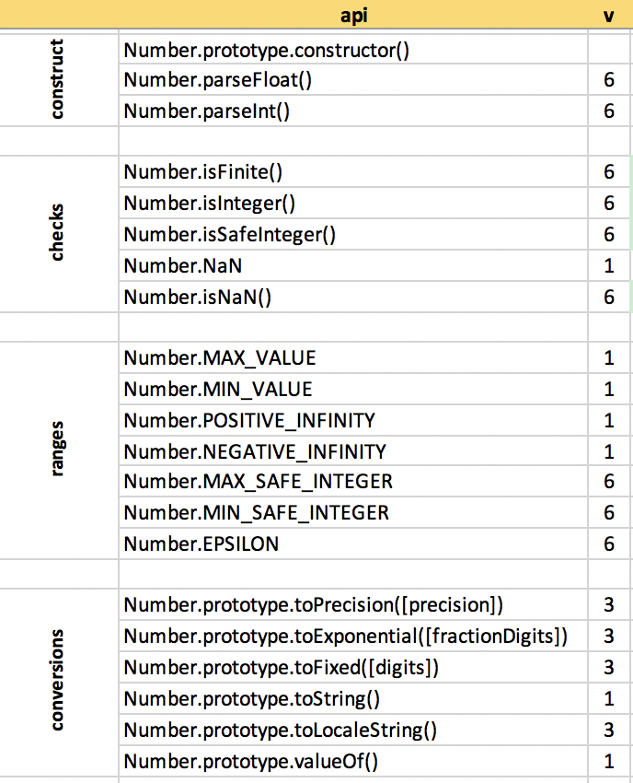
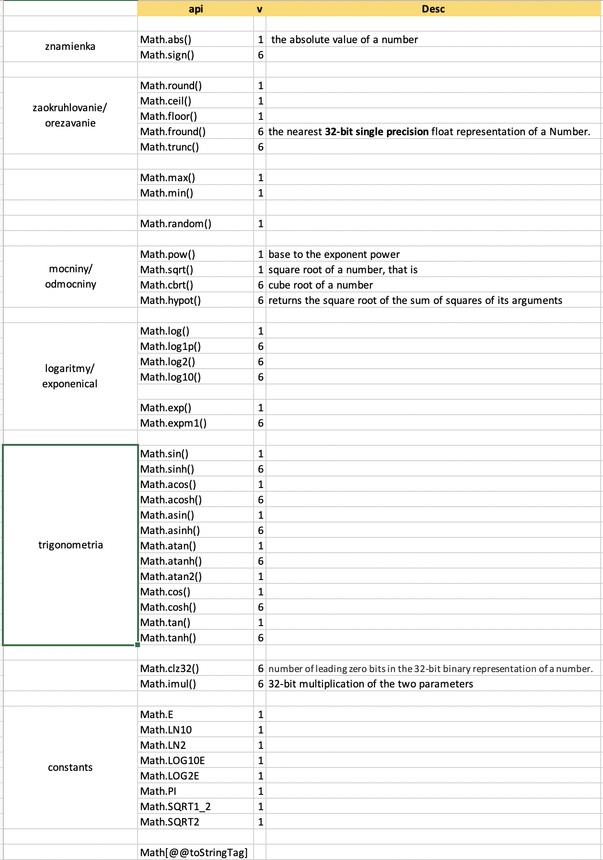
Number API
Number, Math and operators

Slide 21
booleans
literals – true, false
operators - applicable on booleans or in corecion - || and && are not only logical operators but could be called selectors
The || operator returns the left-most truthy operand. If no truthy operand is provided, it returns the right-side operand.
The && operator returns the right-most falsy operand. If no falsy operand is provided, it returns the right-side operand.
no API - only Boolean()
conversions and coercions –
truthy and falsy values (see coercion chapter)
If, while, for, ... and context coercion
typeof - and checking if true/false, or truthy/falsy

Slide 22
Dates
constructors – from numbers, strings, date vs datetime, incorrect dates
Date – API of build in Date object
mutable, immutable, utc, local, timezone support
operators and Dates
i18n – formating, timezones
Conversions and coercion
Standardized formats
mills, date is number – epoch
checking if Date

Slide 23
RegExp
literal vs. constructor
Regular expressions features supported in JS
RegExp – API of build in
regexp and usage in other APIs
unicode strings and regexps
unsafe regexps (ReDoc, injection)
checking if RegExp

Slide 24
Array
literal, constructor, Array.of
sparse arrays, array like objects, iterable objects,
Array – API of arrays
mutable, imutable, array compr.
sorting
Functional (map,...reduce,...)
operators and syntax - arr[i], str[i],object[k]
Conversions and coercion
set, map, objects
old [] vs. new Iterators, generators
checking if Array

Slide 25
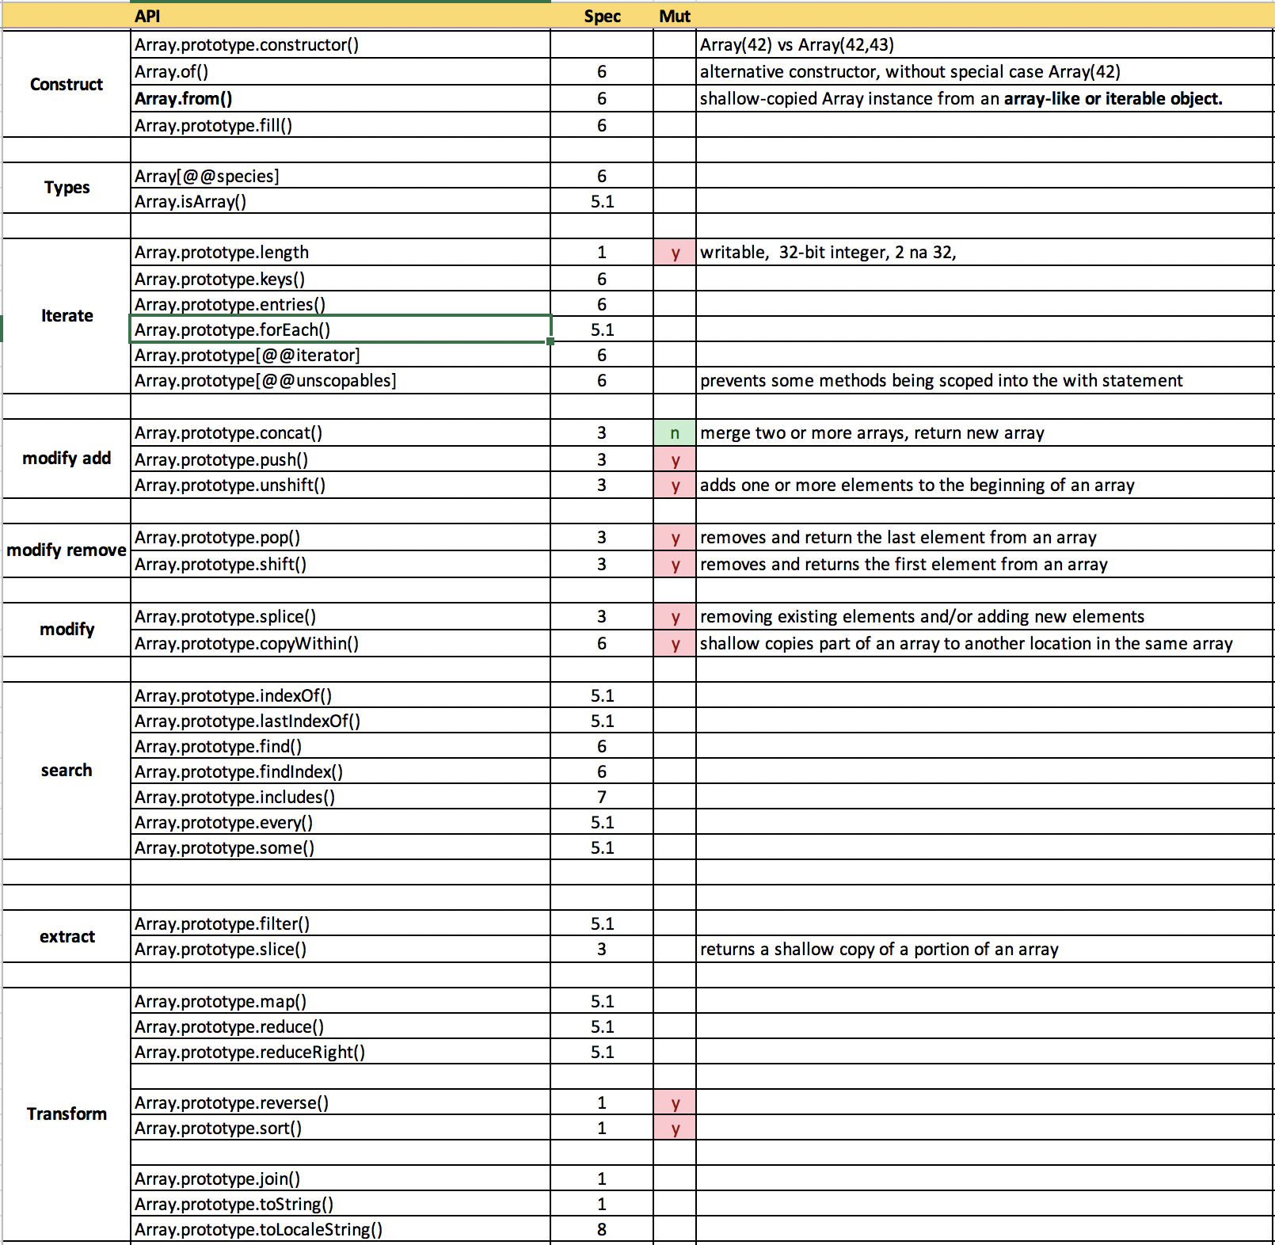
Array API

Slide 26
Set
The Set object lets you store unique values of any type, whether primitive values or object references
API of Set object
Equality algorithm
Iterating
Basic set operations – union, intersection
Conversions - arrays, iterables, strings

Slide 27
Map
The Map object holds key-value pairs. Any value (both objects and primitive values) may be used as either a key or a value
Map vs. Object (as map)
Keys in Object - Strings and Symbols,
Keys in Map - any value, functions, objects, and any primitive.
Keys in Map are ordered, iteration order = insertion order
may perform better in scenarios involving frequent addition and removal of key pairs
API of Map
Conversions – array, iterable, Object, JSON
http://2ality.com/2015/08/es6-map-json.html

Slide 28
Map vs Object[]
https://medium.com/front-end-weekly/es6-map-vs-object-what-and-when-b80621932373
TODO: review

Slide 29
Other Data Structures
ArrayBuffer
DataView
Int*Array
UInt*Array
Float*Array
SharedArrayBuffer
Atomics
https://developer.mozilla.org/en-US/docs/Web/JavaScript/Typed_arrays
https://developer.mozilla.org/en-US/docs/Web/JavaScript/Reference/Global_Objects/Atomics

Slide 30
Binary data
Why do we need to work with binnary data
browser APIs that work with binary data
File API
XMLHttpRequest
Fetch API
Canvas
WebSockets
Web Bluetooth API
And more
node.js - interaction with octet streams in TCP streams, file system operations, and other contexts use Buffer (binary data)

Slide 31
Binary data
Instances of ArrayBuffer store the binary data to be processed.
Two ways to work with them:
Typed Arrays (Uint8Array, Int16Array, Float32Array, etc.) interpret the ArrayBuffer as an indexed sequence of elements of a single type.
DataViews let you access data as elements of several types (Uint8, Int16, Float32, etc.), at any byte offset inside an ArrayBuffer.
Node.js - Prior to the introduction of TypedArray, the JavaScript language had no mechanism for reading or manipulating streams of binary data. The Buffer class was introduced as part of the Node.js API to enable interaction with octet streams in TCP streams, file system operations, and other contexts.
With TypedArray now available, the Buffer class implements the Uint8Array API in a manner that is more optimized and suitable for Node.js.
http://2ality.com/2015/09/typed-arrays.html

Slide 32
Coercion Samples

Slide 33
Coercion
converting a value from one type to another - number to string, object to boolean,...
explicit- developer expresses the intention to convert between types String(x), Number(x)
implicit - forced by the rules of how a value is used, operators, statements, functions +,-, <, >,==, if(){},isFiniteNumber()
any type is a valid subject for type coercion, primitive or object,
results of ceorcion is one of the scalars: string, number, or boolean
Keďže sme v loosly typed jazyku, musíme vedieť ako funguje, ako ju používať a nepoužívať

Slide 34
Coercion
forced by the rules of how a value is used, operators, statements, functions
any type is a valid subject for type coercion, primitive or object, results of coercion is one of the scalars: string, number, or boolean
there are only three types of conversion in JavaScript:
ToString
ToBoolean
ToNumber
conversion logic for primitives and objects works differently, but both primitives and objects can only be converted in those three ways

Slide 35
Coercion – what is it
Convert one of the types:
undefined
null
boolean
number
string
object
Based on the:
operation
or context
To one of primitive types:
number
string
boolean
coercion
boolean
type1
op
type2
number
string
Samples:
str
+
number
str
-
number
if
arr.length
Date
>
number

Slide 36
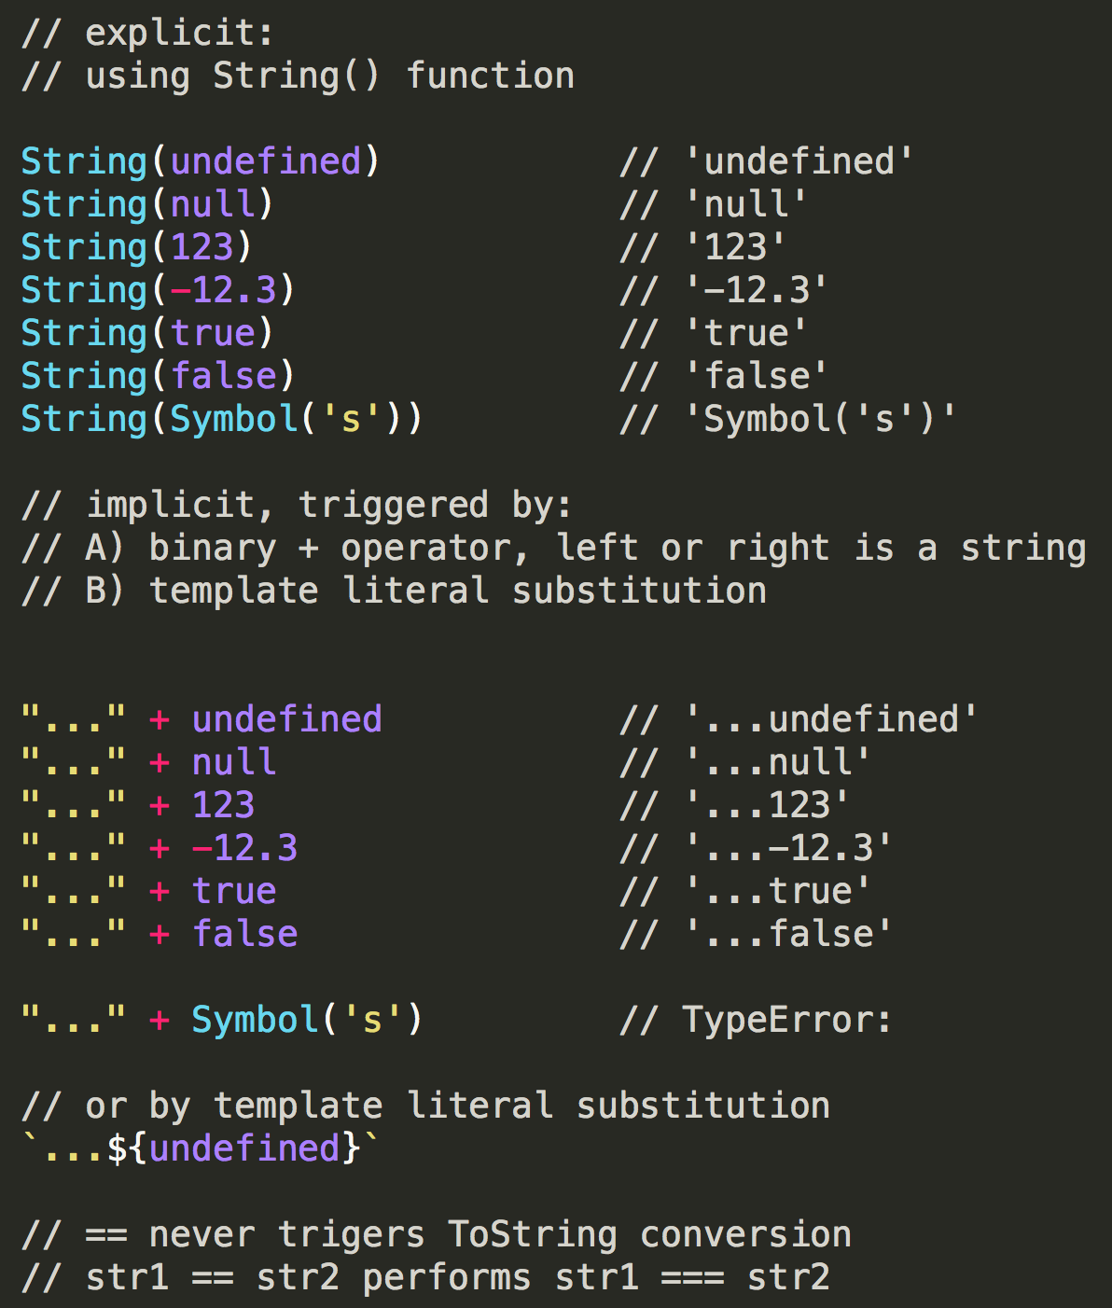
ToString
String(prim)
str + p, p + str
Template Literal Substitution

Slide 37
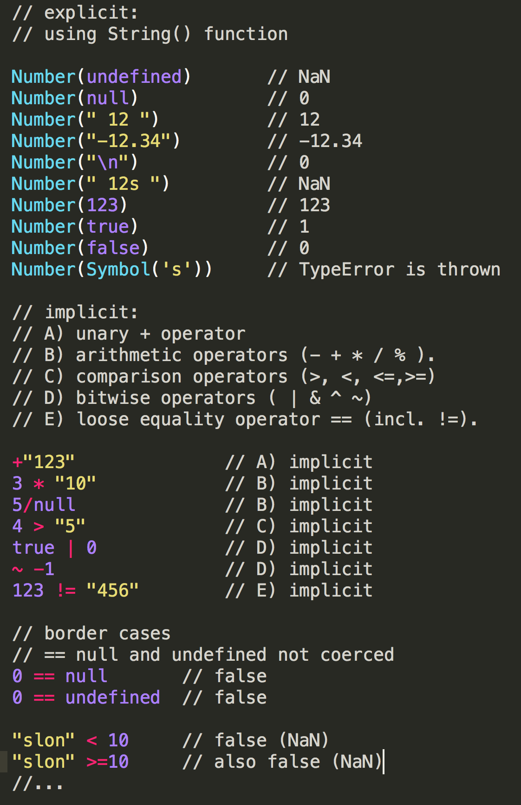
ToNumber
Number(prim)
unary + operator
arithmetic operators
comparison operators
bitwise operators
loose equality operator == (incl. !=)
number compared with string or boolean
NaN != NaN

Slide 38
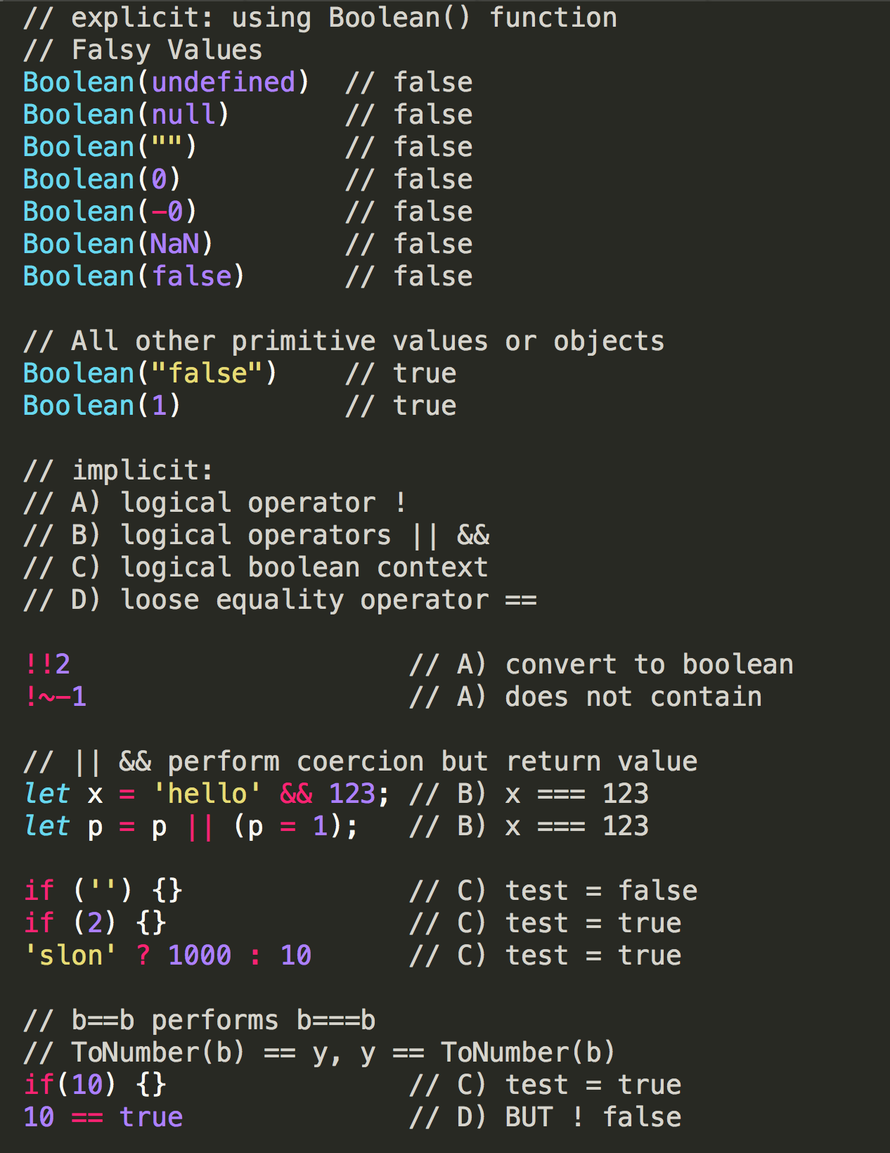
ToBoolean
falsy values
Boolean(prim)
logical operator !
logical operators && ||
logical boolean context
if, for, while,…
loose equality operators ==, !=
b==b performs b===b
ToNumber(b) == y,
y == ToNumber(b)

Slide 39
Coercion of Objects
RECAP: any type is a valid subject for type coercion, primitive or object, results of coercion is one of the scalars: string, number, or boolean
A) JS podľa použitia(operácie zistí načo ho treba konvertovať
Ak na:
boolean
true
string
ToString(ToPrimitive(„string“))
number
ToNumber(ToPrimitive(„number“))
???
ToPrimitive(„default“)

Slide 40
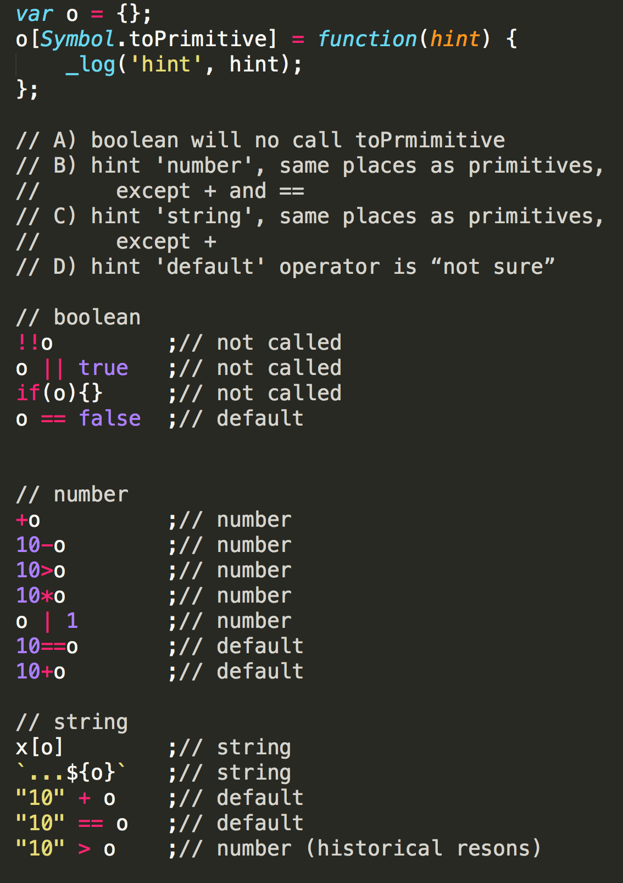
To Primitive kedy a ako sa volá
not used when boolean is needed by op
problematic hybrid operators use default
+
==, !=
<>
Other places where coercion happens are the same as for primitives

Slide 41
To Primitive ako funguje
http://www.ecma-international.org/ecma-262/5.1/#sec-9.1
Každý objekt v JS môže mať metódy:
[[@@toPrimitive]]
toString
valueOf
The conversion algorithm is:
Call obj[Symbol.toPrimitive](hint) if the method exists,
Otherwise if hint is "string"
try obj.toString() and obj.valueOf(), whatever exists, and returns primitive
Otherwise if hint is "number" or "default"
try obj.valueOf() and obj.toString(), whatever exists and returns primitive
If final result is primitive of wrong type perform primitive coercion
https://gist.githubusercontent.com/samoshkin/baf070ab19b73f4f39ec54149fb37c30/raw/c8b9a92707f9e52a14d23360130814255882ee5b/js-to-primitive-internal.js

Slide 42
valueOf, toString
valueOf method to convert an object to a primitive value
JavaScript automatically invokes it when encountering an object where a primitive value is expected
valueOf method is inherited by every object descended from Object.
wrapper build-in objects override this method to return an appropriate primitive value
If an object has no primitive value, valueOf returns the object itself.
toString returns a string representing the object
automatically called when the object is to be represented as a text value or when an object is referred to in a manner in which a string is expected
the toString() method is inherited by every object descended from Object
build-in objects override this method (see individual docs)
If this method is not overridden in a custom object, toString() returns "[object type]"
https://developer.mozilla.org/en-US/docs/Web/JavaScript/Reference/Global_Objects/Object/valueOf
https://developer.mozilla.org/en-US/docs/Web/JavaScript/Reference/Global_Objects/Object/toString

Slide 43
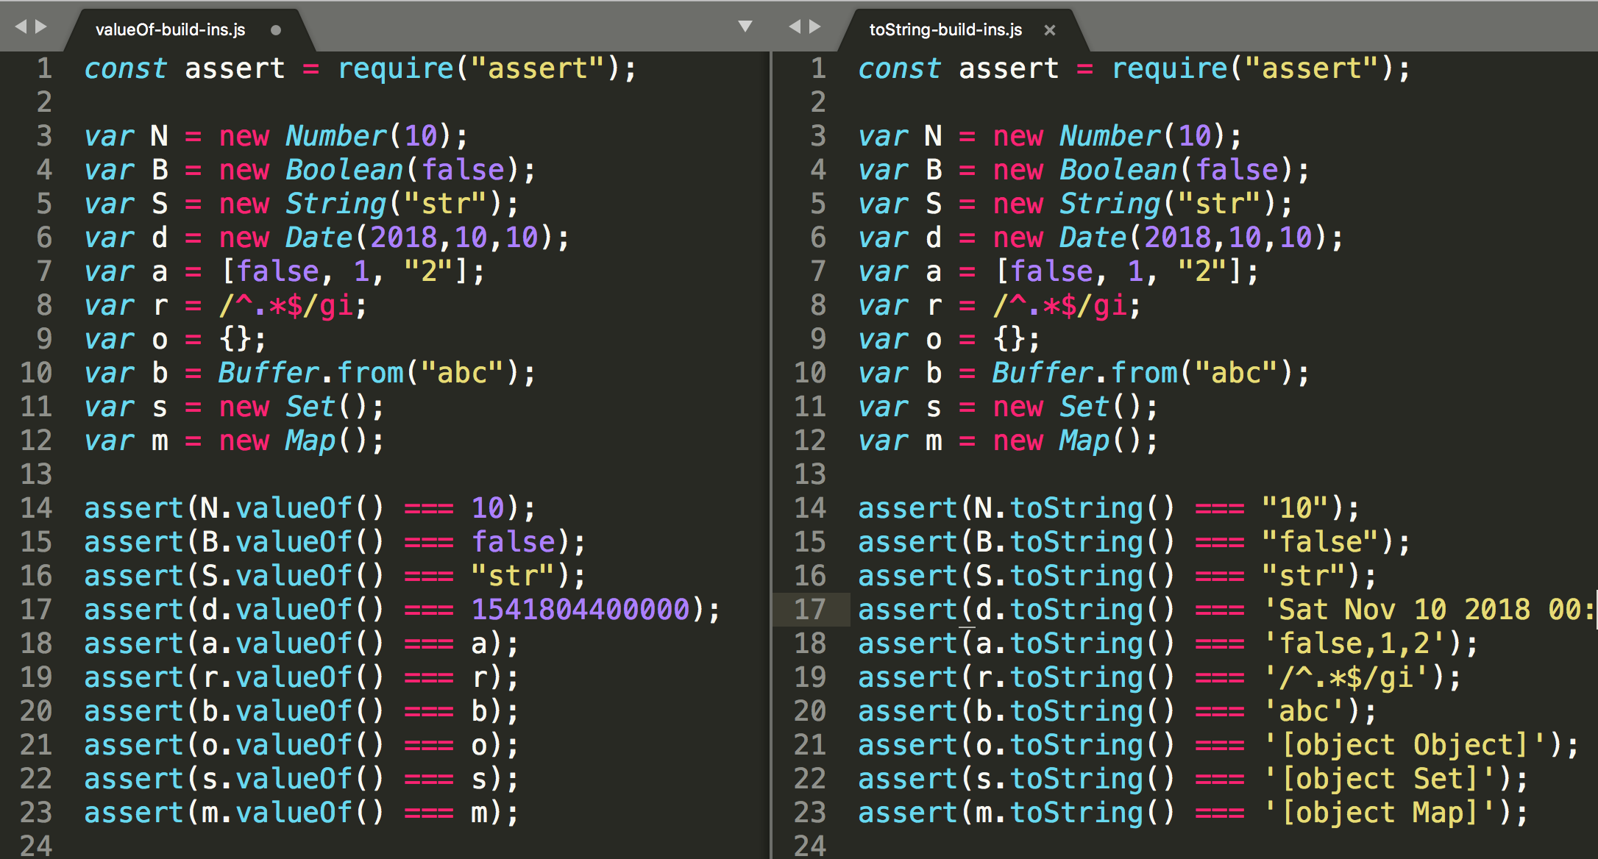
valueOf, toString
primitive
mils
object

Slide 44
Coercion
Summary – now you know almost all pieces of puzzle
how 6 primitives are converted to s,b,n
how object are converted to s,b,n
what operators trigger coerction
Let’s see whole alg. in diagram.

Slide 45
Coercion – what is it ? (RECAP)
Convert one of the types:
undefined
null
boolean
number
string
object
Based on the:
operation
or context
To one of primitive types:
number
string
boolean
coercion
boolean
type1
op
type2
number
string
Samples:
str
+
number
str
-
number
if
arr.length
Date
>
number

Slide 46
Coercion – how it works
Convert to:
ToBoolean
number
string
boolean
boolean
ToNumber
number
ToString
string
primitive
op
type2
object
boolean
true
Convert to:
ToNumber
number
number,
string,
default
ToPrimitive
hint
ToString
string
@@toPrimitive(hint)
number,
default
valueOf()
toString()
string,
or Date default
toString()
valueOf()

Slide 47
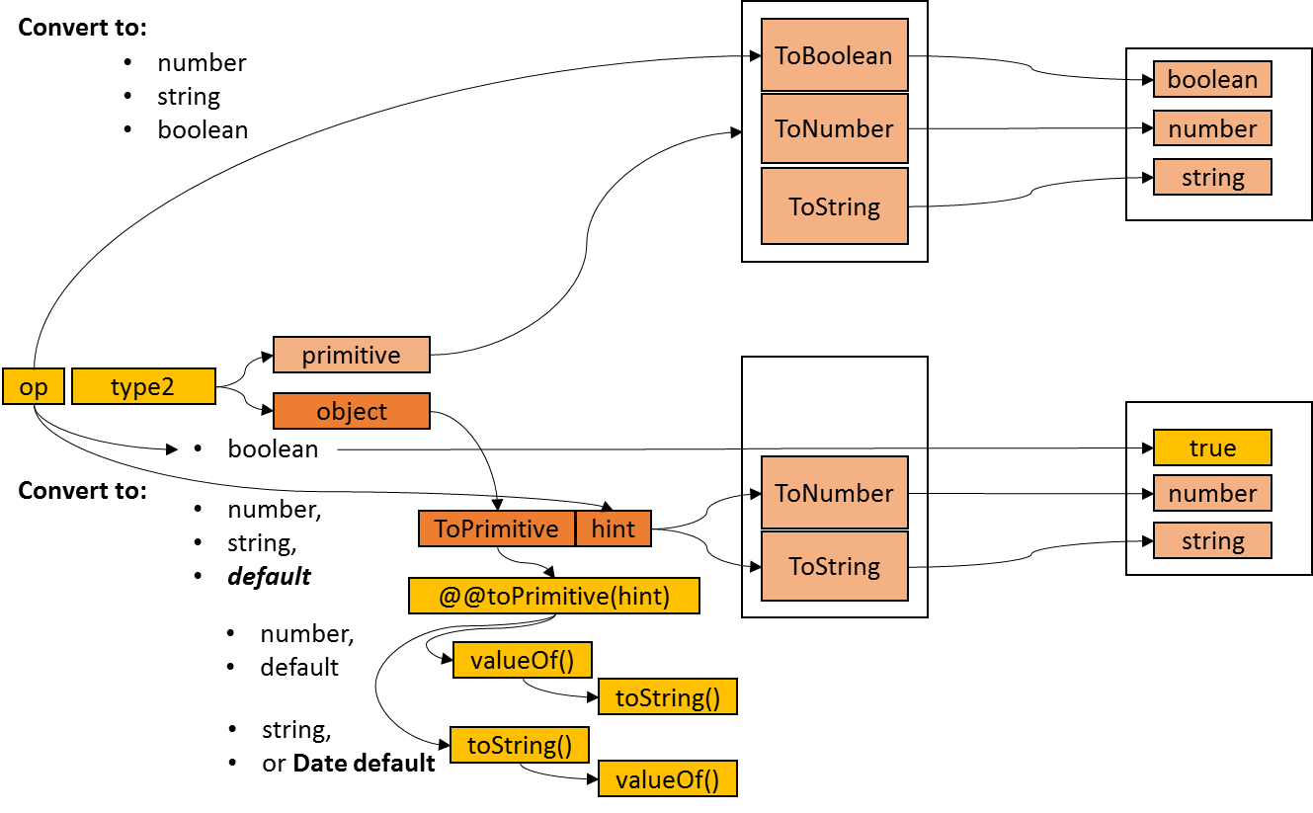
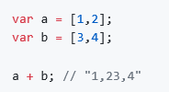
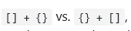
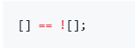
Examples
TODO:

Slide 48
Coercion
So, is implicit coercion evil? Is it dangerous? Is it a flaw in JavaScript's design? Should we avoid it at all costs?
it’s a great source of frustration and defects
useful mechanism that allows us to write less code without losing the readability
https://github.com/getify/You-Dont-Know-JS/blob/master/types%20%26%20grammar/ch4.md

Slide 49
Useful coercion
It's extremely common/idiomatic to (implicitly) coerce number to string with a + "" operation
Operators || and && - They result in the value of one (and only one) of their two operands. In other words, they select one of the two operand's values
~, !~, contains does not contain
default value assignment idiom is so common (and useful!) that even those who publicly and vehemently decry JavaScript coercion often use it in their own code
loose equals for null
…

Slide 50
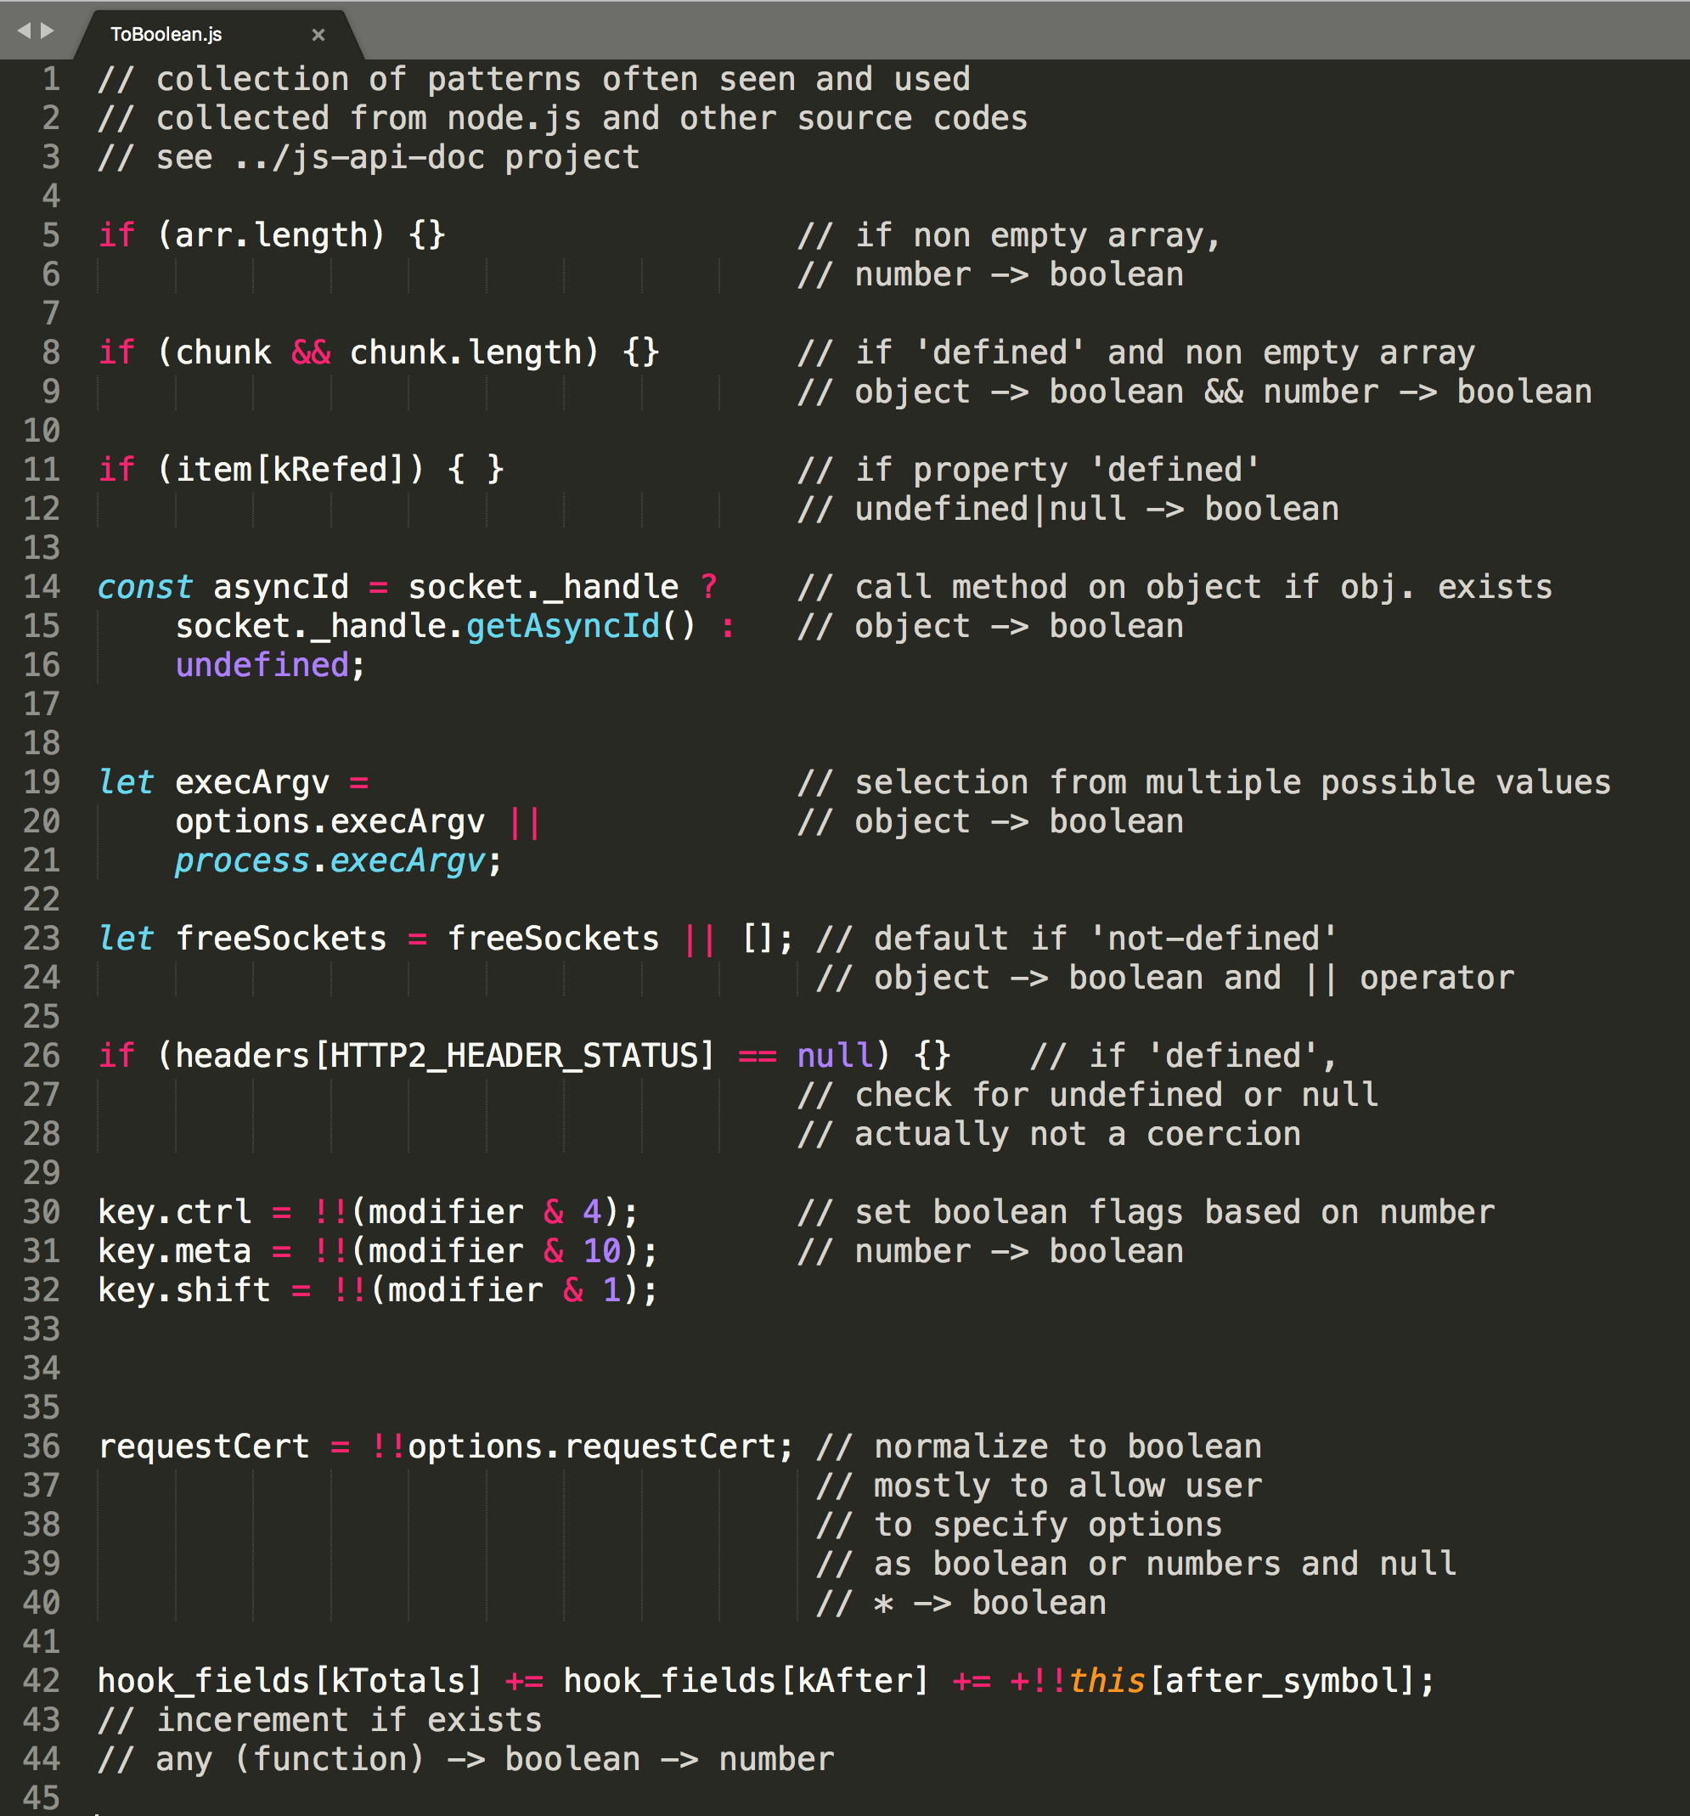
Useful coercion

Slide 51
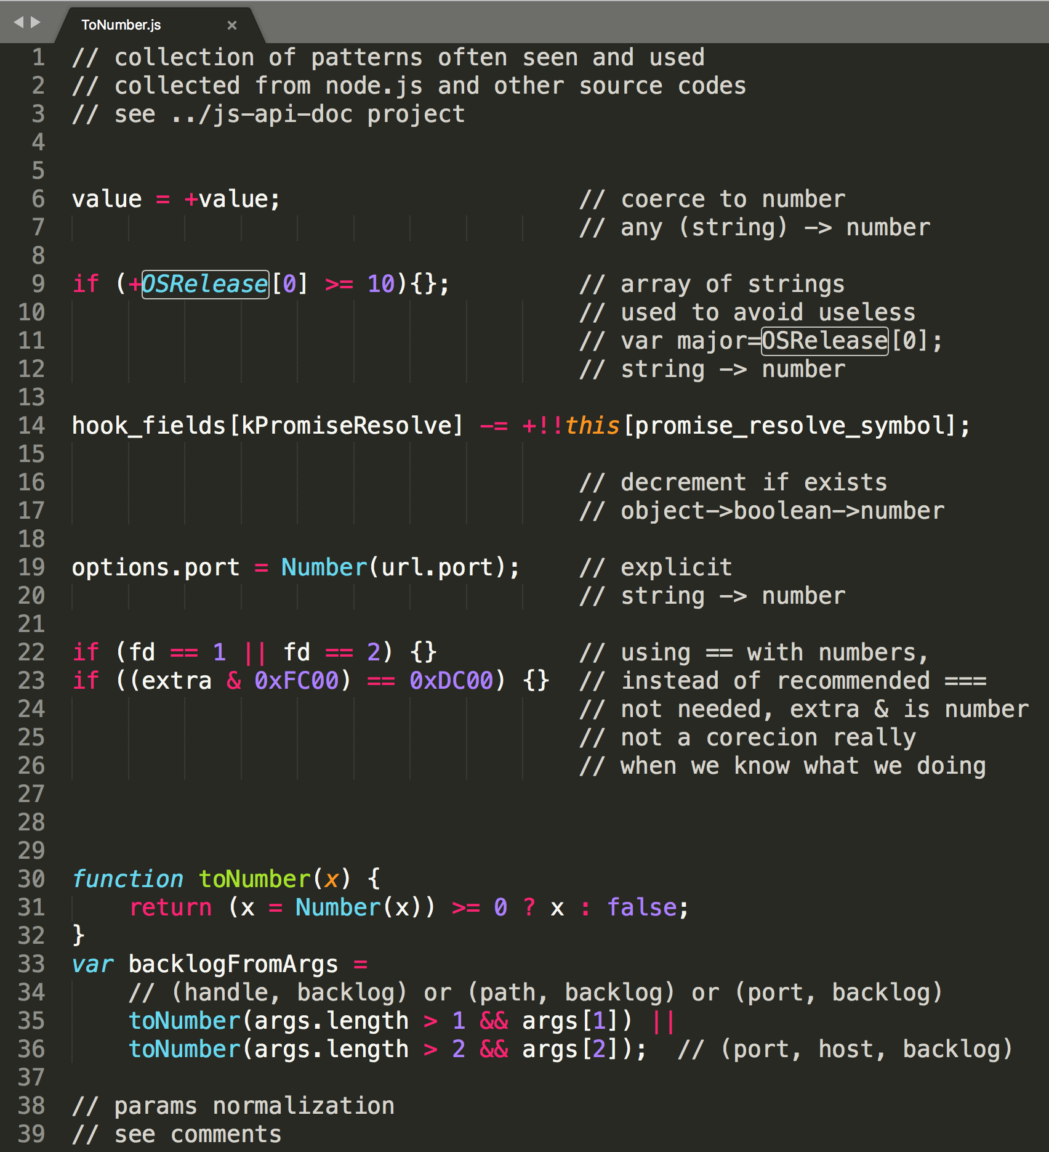
Useful coercion

Slide 52
Coercion and ES Evolution
for coercion:
agains coercion:
The substr function is intentionally generic; it does not require that its this value be a String object. Therefore it can be transferred to other kinds of objects for use as a method.
New functions appear in API without coercion: Number.isFinite(), Number.isNaN()
Object.create(null)

Slide 53
equality
4 algoritmy
Strict Equality Comparison
Abstract Equality Comparison
SameValue
SameValueZero
Líšia sa iba v porovnávaní primitívnych typov, porovnávanie objektov je vždy na základe referencií

Slide 54
equality
==
Lax To Strict:
==
===
SameValueZero
SameValue
Abstract
Not same type
If x is null and y is undefined, return true.
If x is undefined and y is null, return true.
If Type(x) is Number and Type(y) is String, return the result of the comparison x == ToNumber(y).
If Type(x) is String and Type(y) is Number, return the result of the comparison ToNumber(x) == y.
If Type(x) is Boolean, return the result of the comparison ToNumber(x) == y.
If Type(y) is Boolean, return the result of the comparison x == ToNumber(y).
If Type(x) is either String, Number, or Symbol and Type(y) is Object, return the result of the comparison x == ToPrimitive(y).
If Type(x) is Object and Type(y) is either String, Number, or Symbol, return the result of the comparison ToPrimitive(x) == y.
Return false.
If Type(x) is the same as Type(y), then, Return the result of performing Strict Equality Comparison x === y.
Strict Equality Comparison | SameValueZero | SameValue
If Type(x) is different from Type(y), return false. | If Type(x) is different from Type(y), return false. | If Type(x) is different from Type(y), return false.
If Type(x) is Number, then | If Type(x) is Number, then | If Type(x) is Number, then
If x is NaN, return false.,If y is NaN, return false. | If x is NaN and y is NaN, return true. | If x is NaN and y is NaN, return true.
If x is +0 and y is -0, return true. | If x is +0 and y is -0, return true. | If x is +0 and y is -0, return false.
If x is -0 and y is +0, return true. | If x is -0 and y is +0, return true. | If x is -0 and y is +0, return false.
If x is the same Number value as y, return true. | If x is the same Number value as y, return true. | If x is the same Number value as y, return true.
Return false. | Return false. | Return false.
Return SameValueNonNumber(x, y). | Return SameValueNonNumber(x, y). | Return SameValueNonNumber(x, y).
SameValueNonNumber
Assert: Type(x) is not Number.
Assert: Type(x) is the same as Type(y).
If Type(x) is Undefined, return true.
If Type(x) is Null, return true.
If Type(x) is String, then
If x and y are exactly the same sequence of code units (same length and same code units at corresponding indices), return true; otherwise, return false.
If Type(x) is Boolean, then
If x and y are both true or both false, return true; otherwise, return false.
If Type(x) is Symbol, then
If x and y are both the same Symbol value, return true; otherwise, return false.
Return true if x and y are the same Object value. Otherwise, return false.
null undef
coercion
===
Map, Set,
[].includes,
%TypedArray%,
ArrayBuffer
Object.is
NaN
NaN
0, -0
0, -0

Slide 55

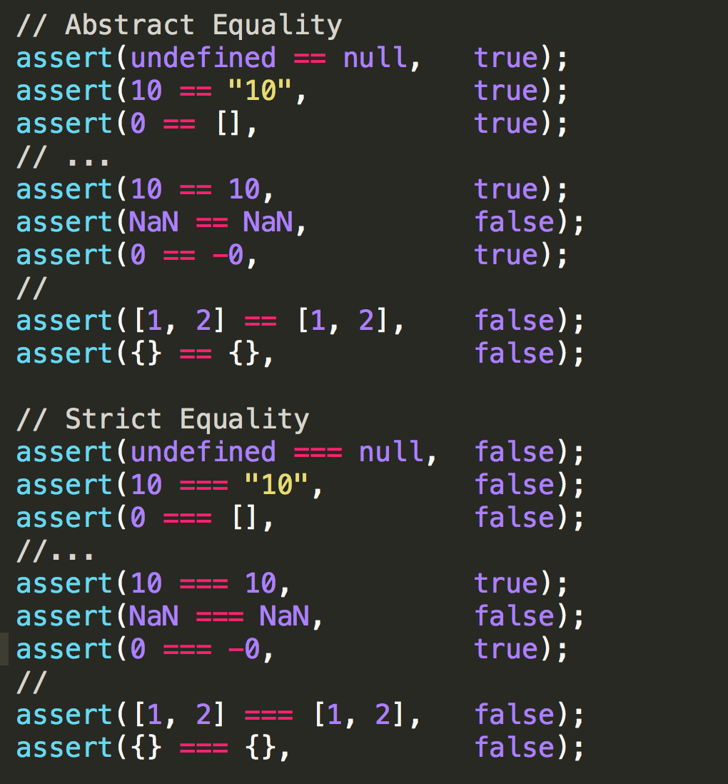
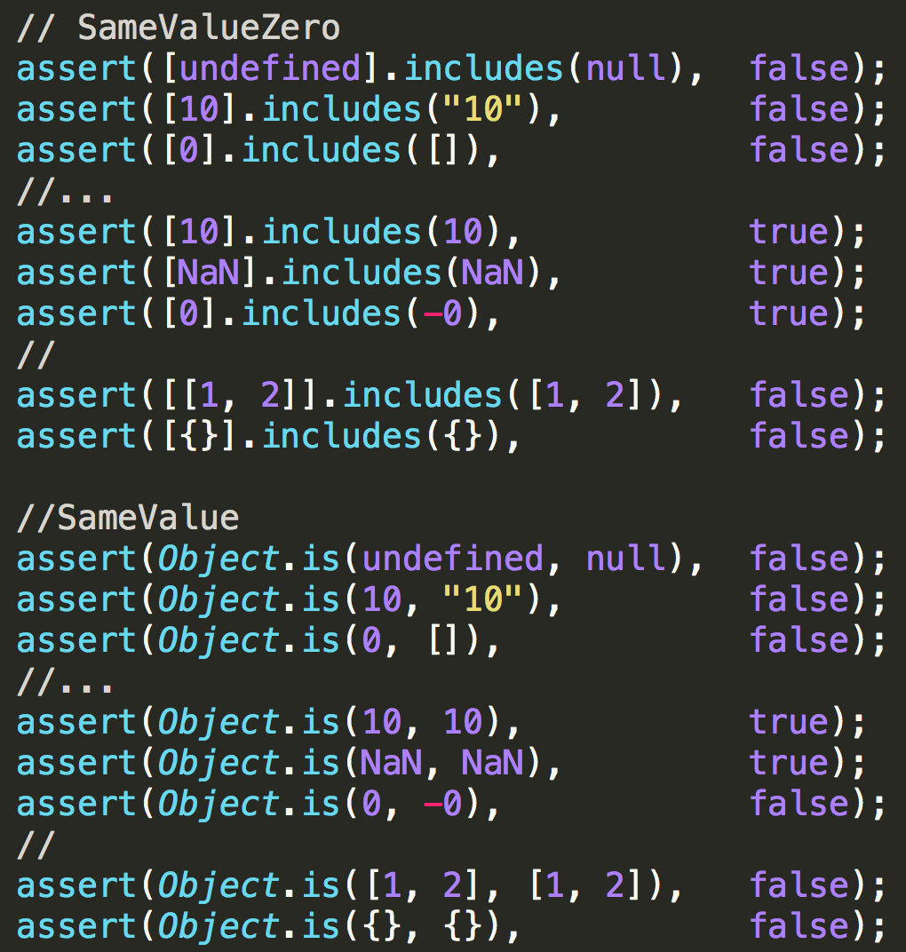
equality

Slide 56
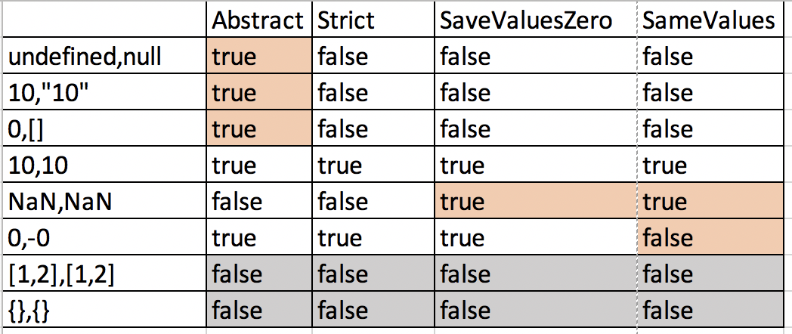
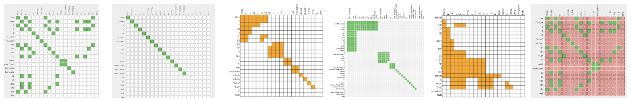
equality
https://github.com/dorey/JavaScript-Equality-Table
Game: https://slikts.github.io/js-equality-game/

Slide 57
ES Versions and Language Evolution
Evolution of
concepts
syntax
apis
deprecations
Contribution to paradigms:
OO
FP
Async
Backward compatibility
ES 2018
ES 2017
ES 2016
ES 2015
ES 5, 5.1
ES 3

Slide 58
ES Versions and Language Evolution
ES 3 (1999/12)
Error Handling
try ... catch
throw
...
ES 2018
ES 2017
ES 2016
ES 2015
ES 5, 5.1
ES 3

Slide 59
ES Versions and Language Evolution
ES 5. 5.1 (2009, 2011)
Array functions (filter, map, reduce,...)
Function.bind
Object immutability (freeze, seal, ...)
Object properties definePropery(),getOwnPropertyDescriptor (), keys()
Object.create
getters, setters
JSON API
strict mode
...
ES 2018
ES 2017
ES 2016
ES 2015
ES 5.1
ES 3

Slide 60
ES Versions and Language Evolution
ES 2015 (6th)
Promise, Generators
arrow functions
destructuring assignment, spread operator
rest and default parameters
Template Strings
block scope variables (let, const)
for..of loop and iterators on build ins
Object.* - setPrototypeOf, assign, is() SameValue equality,
Symbols
Classes
Number.* non coercing functions
String codePoints
Map, Set
Proxy, Reflect
ES 2018
ES 2017
ES 2016
ES 2015
ES 5, 5.1
ES 3

Slide 61
ES Versions and Language Evolution
ES 2016 (7th)
Array.prototype.includes
exponential operator **
ES 2018
ES 2017
ES 2016
ES 2015
ES 5, 5.1
ES 3

Slide 62
ES Versions and Language Evolution
ES 2017 (8th)
Async Functions, await operator
Object
values(), entries()
getOwnPropertyDescriptors()
getters setters deprecation of __ methods
String
padStart(), padEnd()
trailing commas in the function parameters
...
ES 2018
ES 2017
ES 2016
ES 2015
ES 5, 5.1
ES 3

Slide 63
ES Versions and Language Evolution
ES 2018 (9th)
RegExp
Named Group Capture
Lookbehind Assertions
Unicode Property Escapes
Promises
Promise.prototype.finally()
for-await-of
rest and spread for Objects
Shared memory Atomics
Tagged Template literal restriction removed
...
ES 2018
ES 2017
ES 2016
ES 2015
ES 5, 5.1
ES 3

Slide 64
ES Versions and Language Evolution
ES 2019 (10th)
https://medium.com/@selvaganesh93/javascript-whats-new-in-ecmascript-2019-es2019-es10-35210c6e7f4b
ES 2019
ES 2018
ES 2017
ES 2016
ES 2015
ES 5, 5.1
ES 3

Slide 65

_aux

Slide 66
Other Related Languages

Slide 67
Flow - https://flow.org/en/
STATIC TYPE CHECKER FOR JAVASCRIPT
TypeScript
CofeeScript
LiveScript - http://livescript.net
WebAssembly

Slide 68
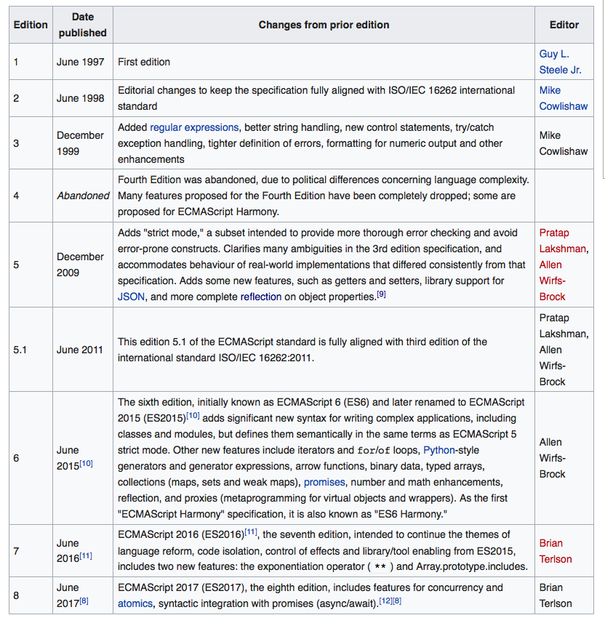
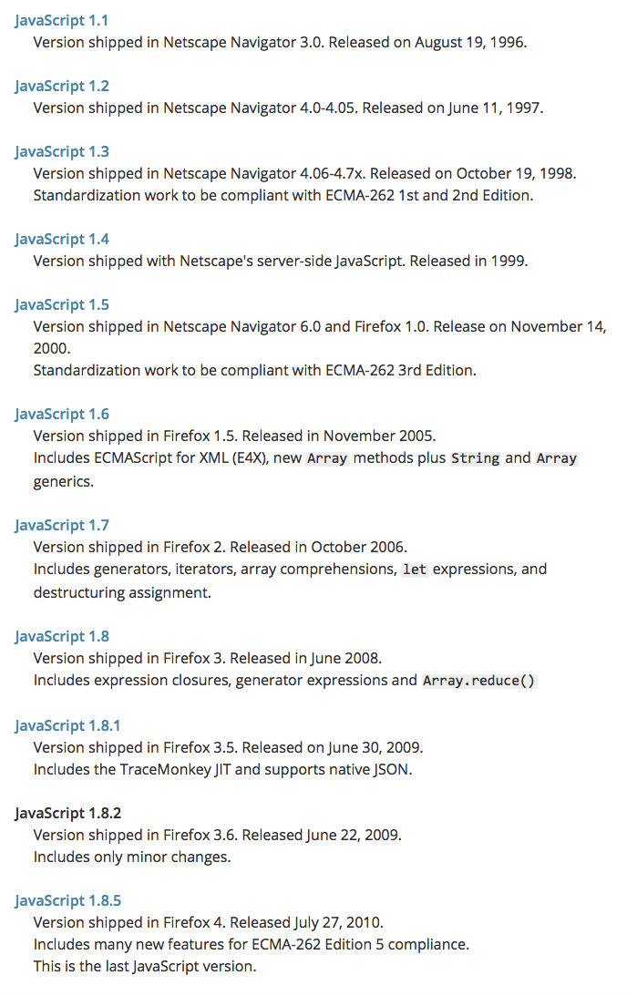
JavaScript, ECMAScript - versions
https://developer.mozilla.org/en-US/docs/Web/JavaScript/New_in_JavaScript

Slide 69
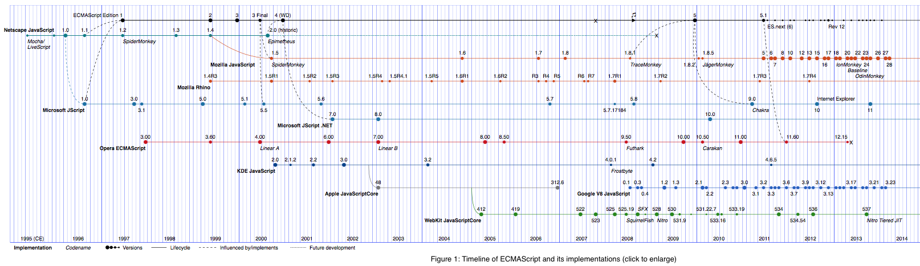
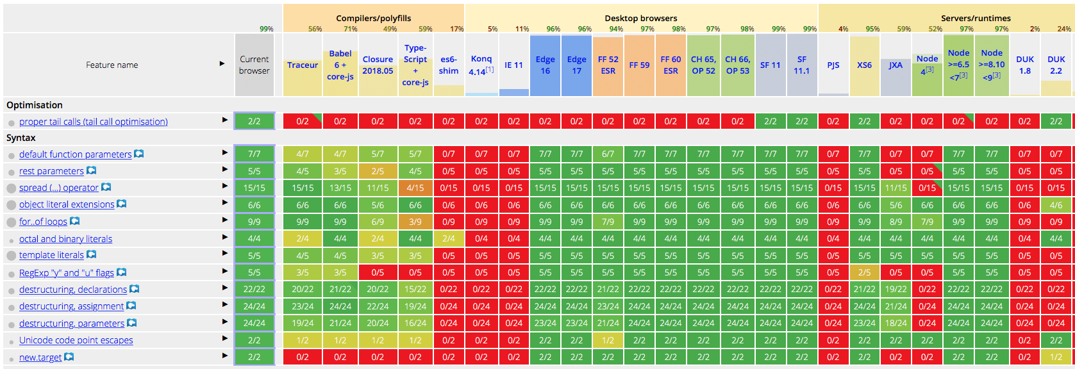
Features by versions and runtimes
http://pointedears.de/scripts/test/es-matrix/
https://kangax.github.io/compat-table/es6/

Slide 70

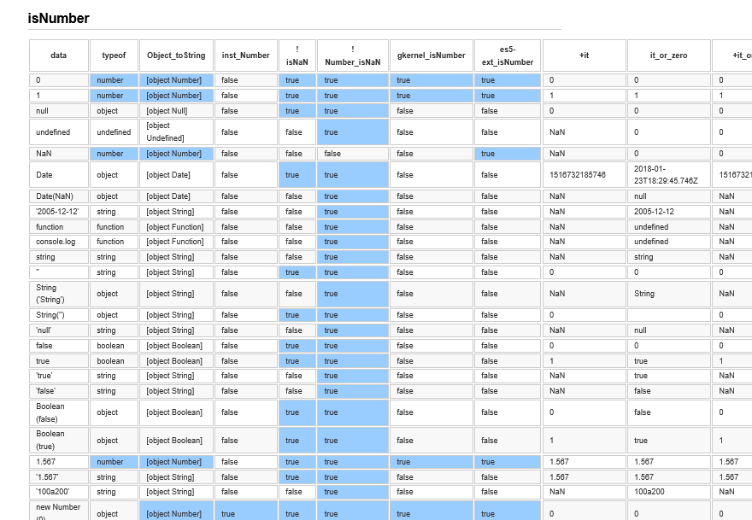

ES – Data Types
Ref Guide, Spec, Books, Tests
Jokes, Blames, …
http://2ality.com/2013/01/categorizing-values.html
http://2ality.com/2013/10/typeof-null.html
https://medium.com/dailyjs/the-why-behind-the-wat-an-explanation-of-javascripts-weird-type-system-83b92879a8db
https://www.destroyallsoftware.com/talks/wat

Slide 71
Variable declarations in wild
let var const in node/lib
$ grasp "var-decs[kind=var]" ../node/lib -r -c | decolorize | clmn-sum 2 ":"
1150
$ grasp "var-decs[kind=let]" ../node/lib -r -c | decolorize | clmn-sum 2 ":"
419
$ grasp "var-decs[kind=const]" ../node/lib -r -c | decolorize | clmn-sum 2 ":"
3294
Neni to presne lebo grasp pada na viacerych zdrojakoch, ale stale sa var dost casto pouziva, otazka znie preco
Nuz napriklad pre toto: Inside loops let is significantly slower see: https://jsperf.com/let-vs-var-loop, co uz zase tiez nie je pravda ;-) vitajte v JS svete

